Slide 1





VPNs in 2024
Ondřej Šika
ondrej@sika.io
@ondrejsika
LinuxDays 2024, Praha, 12. 10. 2024

Slide 2
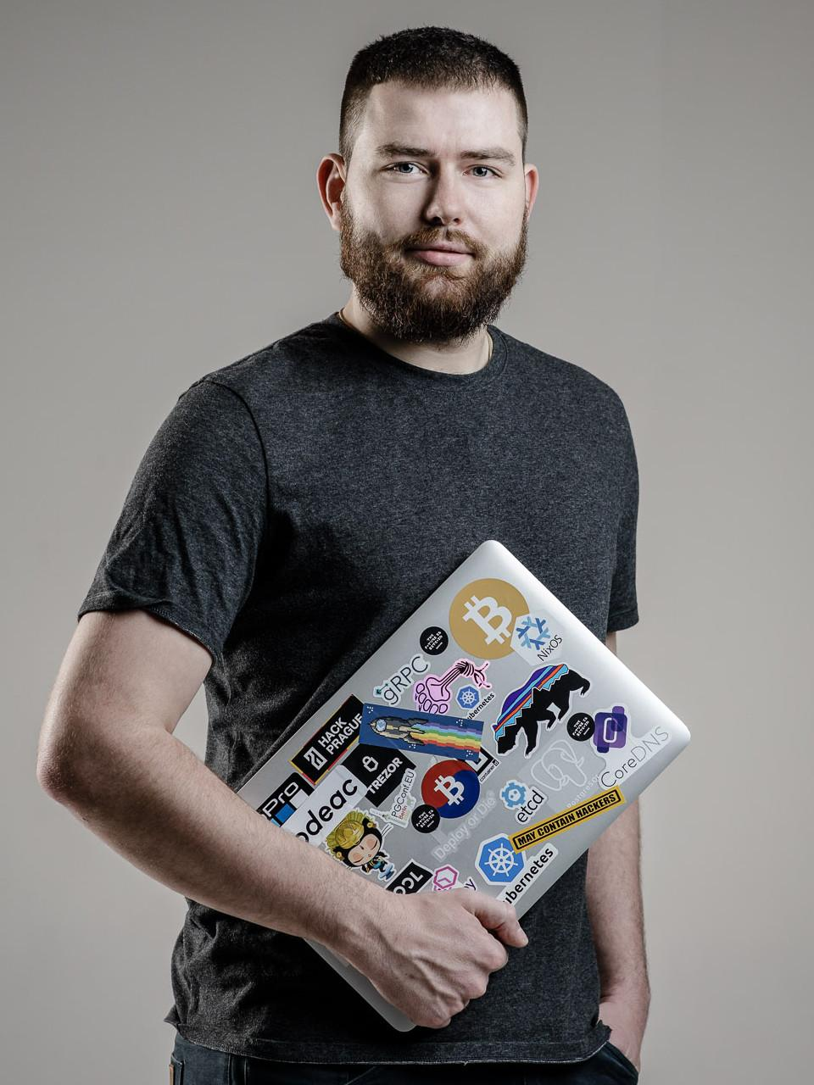
Ondřej Šika
I'm a DevOps engineer and consultant from Prague.
I help companies to set up or improve DevOps to deliver easier, faster and more reliable software products.
I have also popular DevOps training and DevOps company SikaLabs.

Slide 3
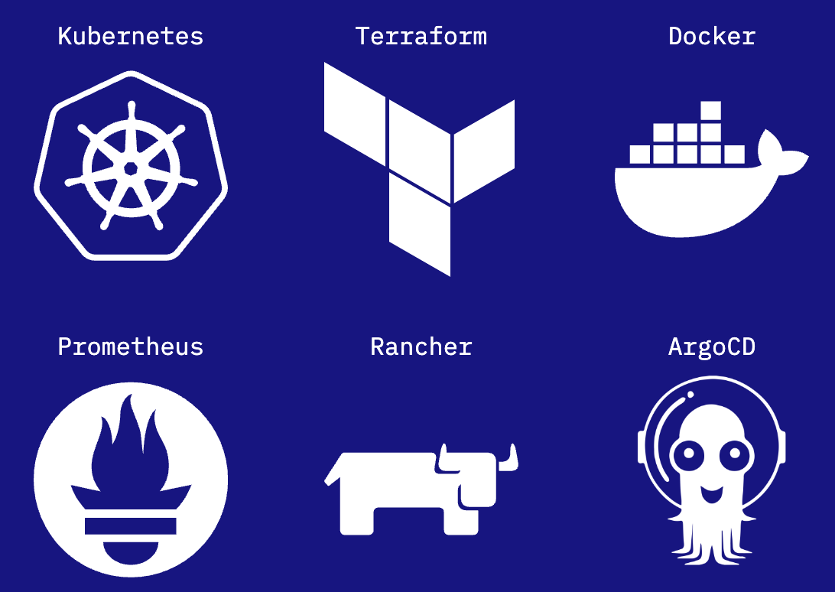
My DevOps Training
I have popular training sessions where I share my knowledge in a way that allows you to do everything yourself, without unnecessary mistakes and dead ends.
Docker
Kubernetes
ArgoCD
Prometheus

Slide 4
Do you need a VPN? 🤔

Slide 5
You don't!

Slide 6


Slide 7

Cloudflare Access
Secure VPN alternative
Identity based Cloudflare Proxy
Zero trust model
Identity based authentication
OIDC (Okta, Keycloak)
Google, Microsoft
Email

Slide 8
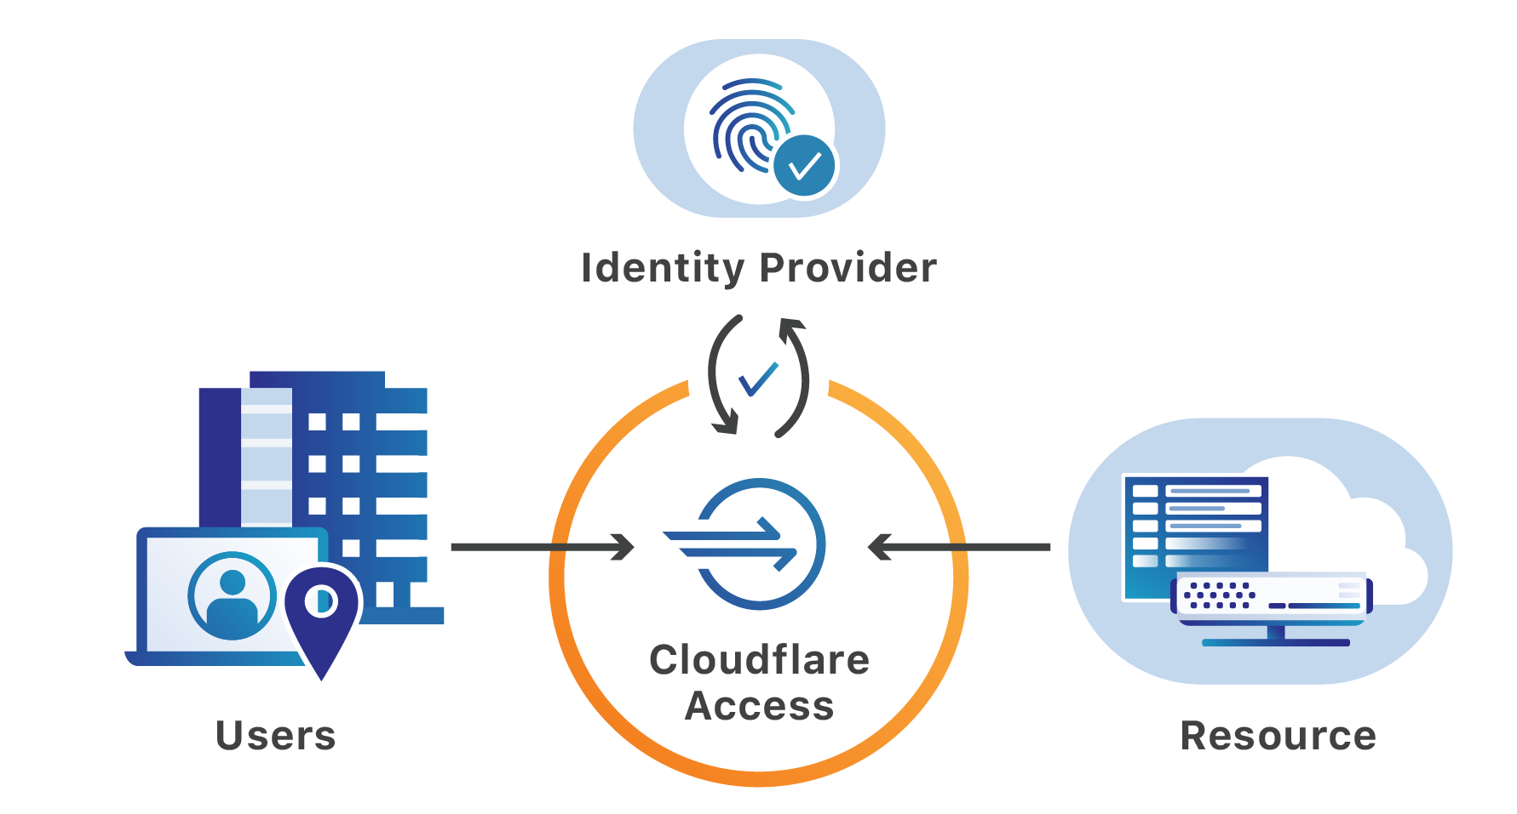

Slide 9
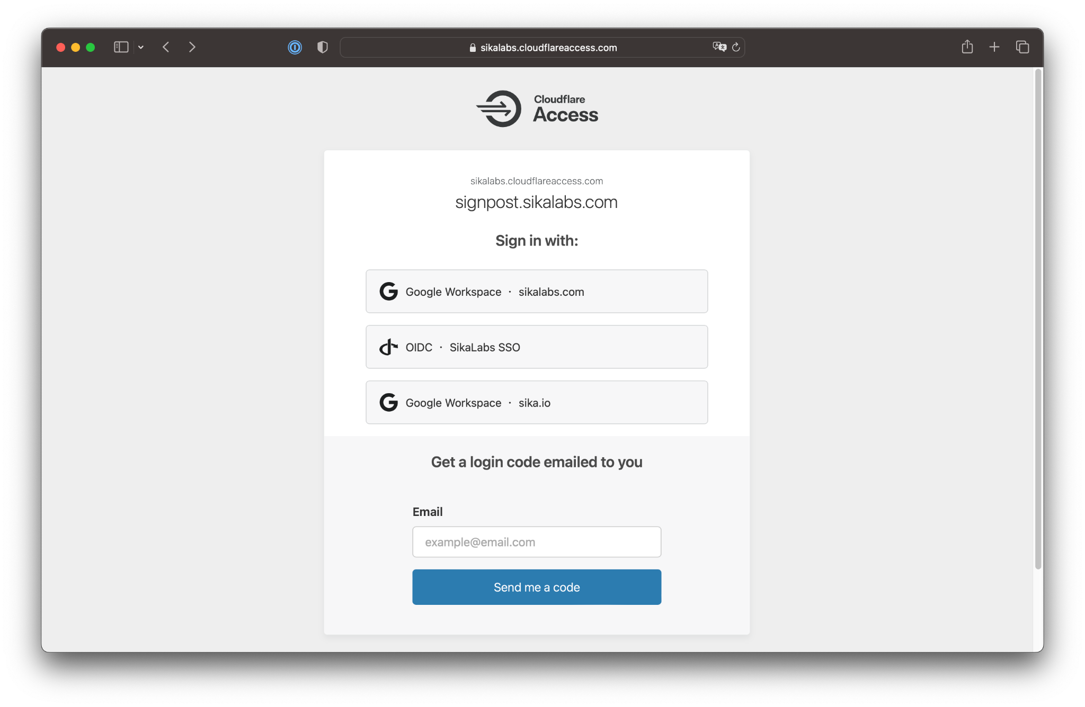

Slide 10
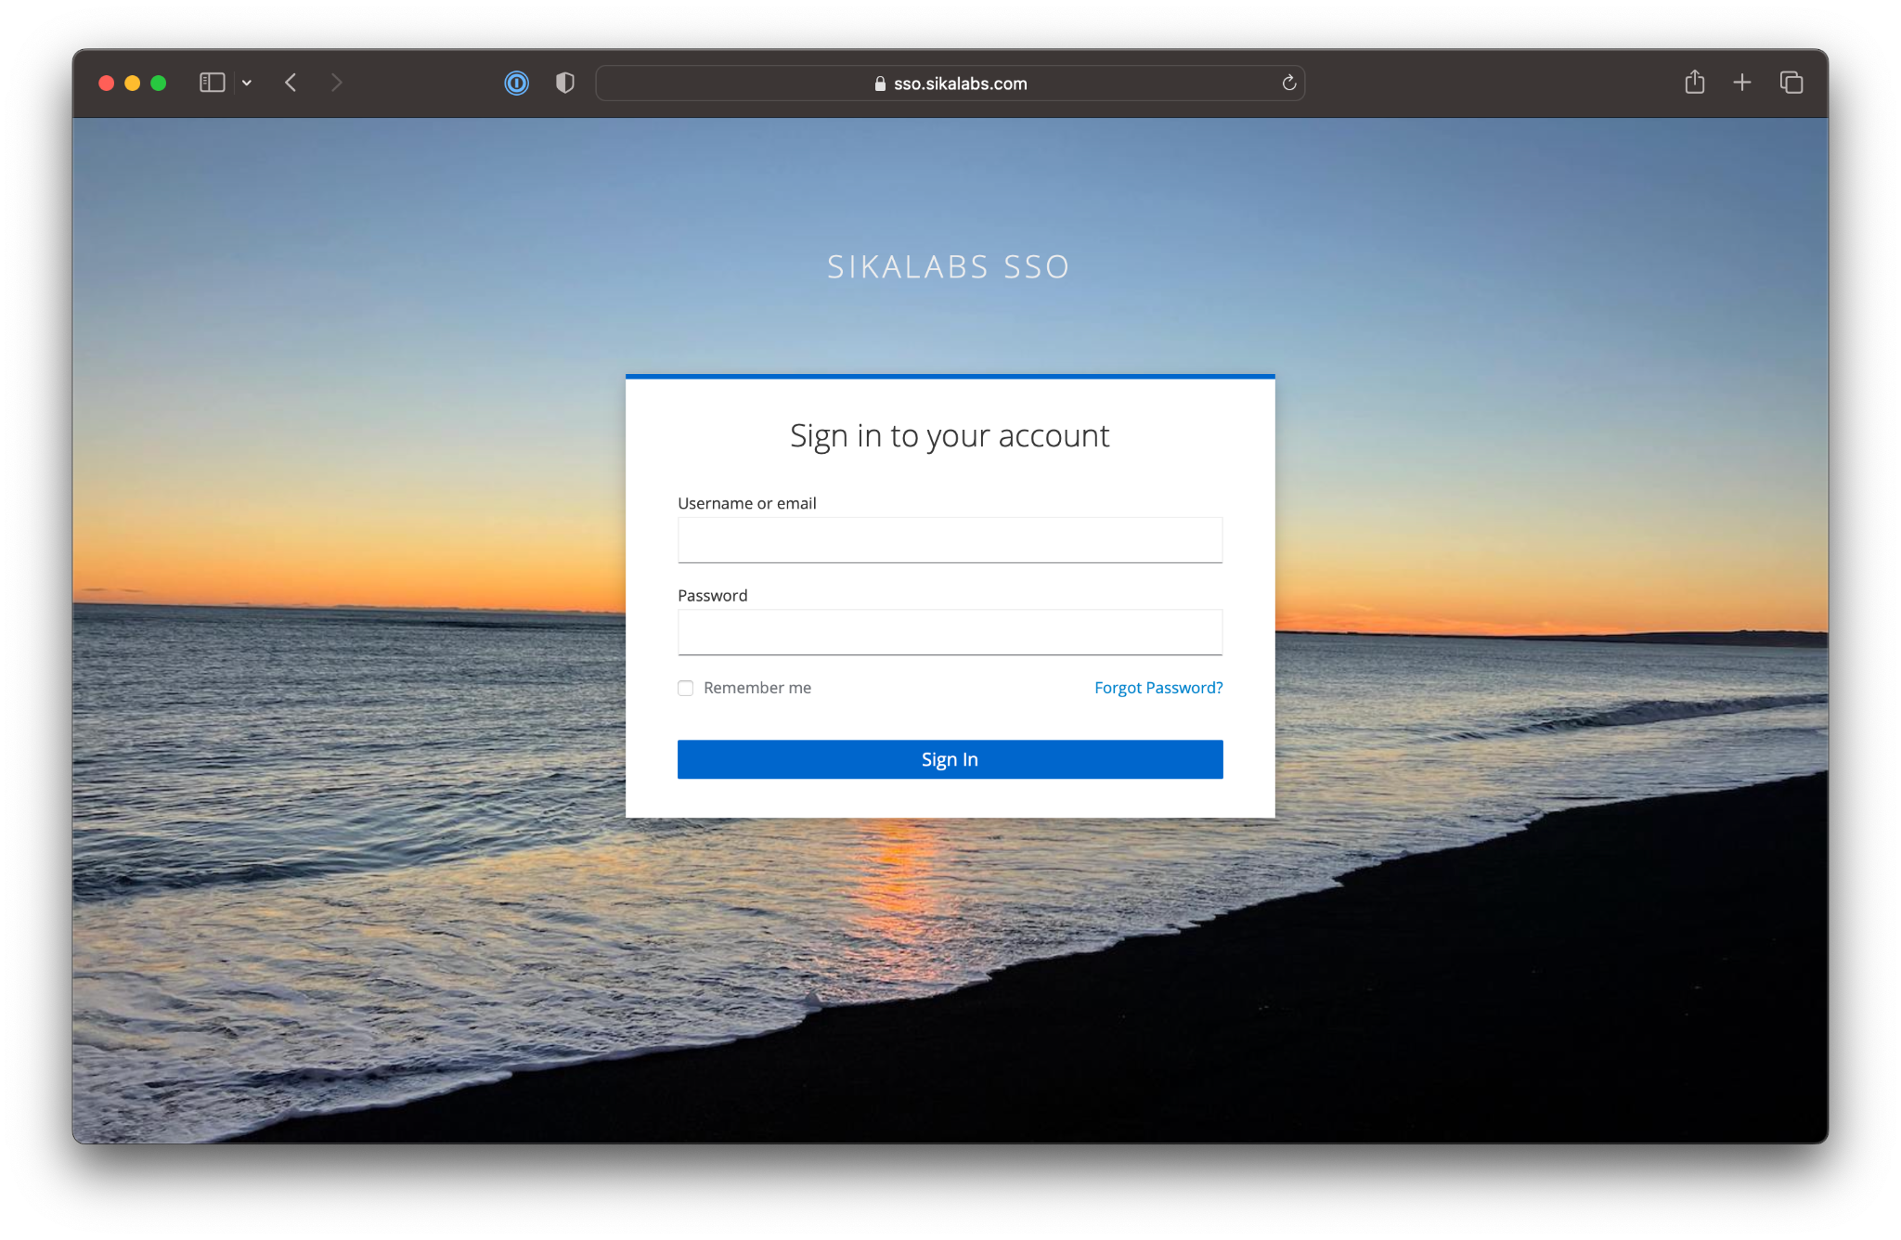

Slide 11
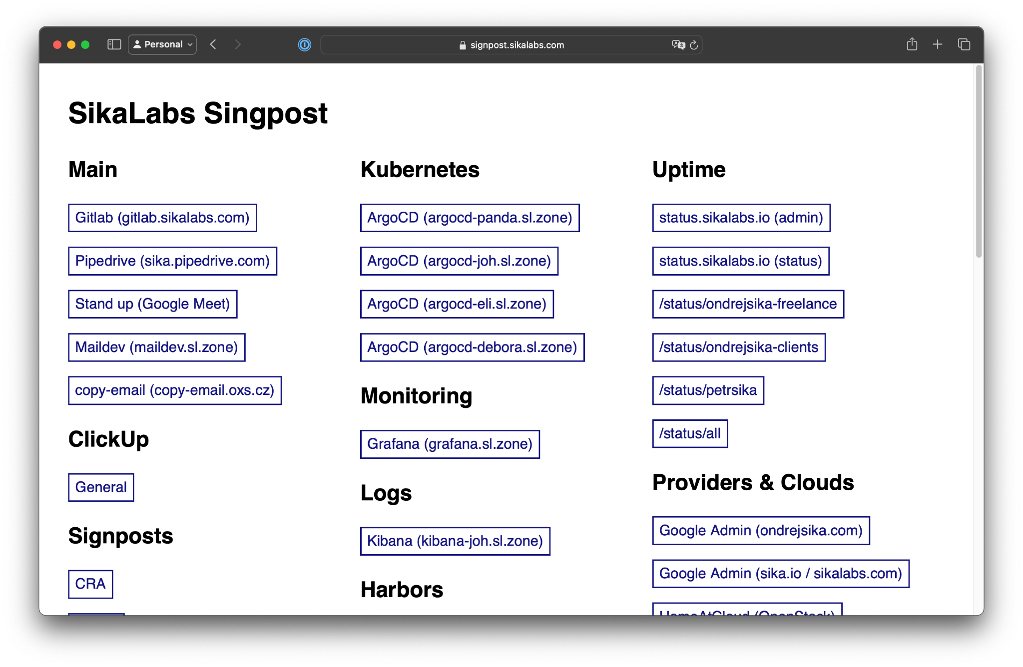

Slide 12
DEMO TIME 🚀🚀

Slide 13
But I don't have public or static IP … 😔

Slide 14


Slide 15
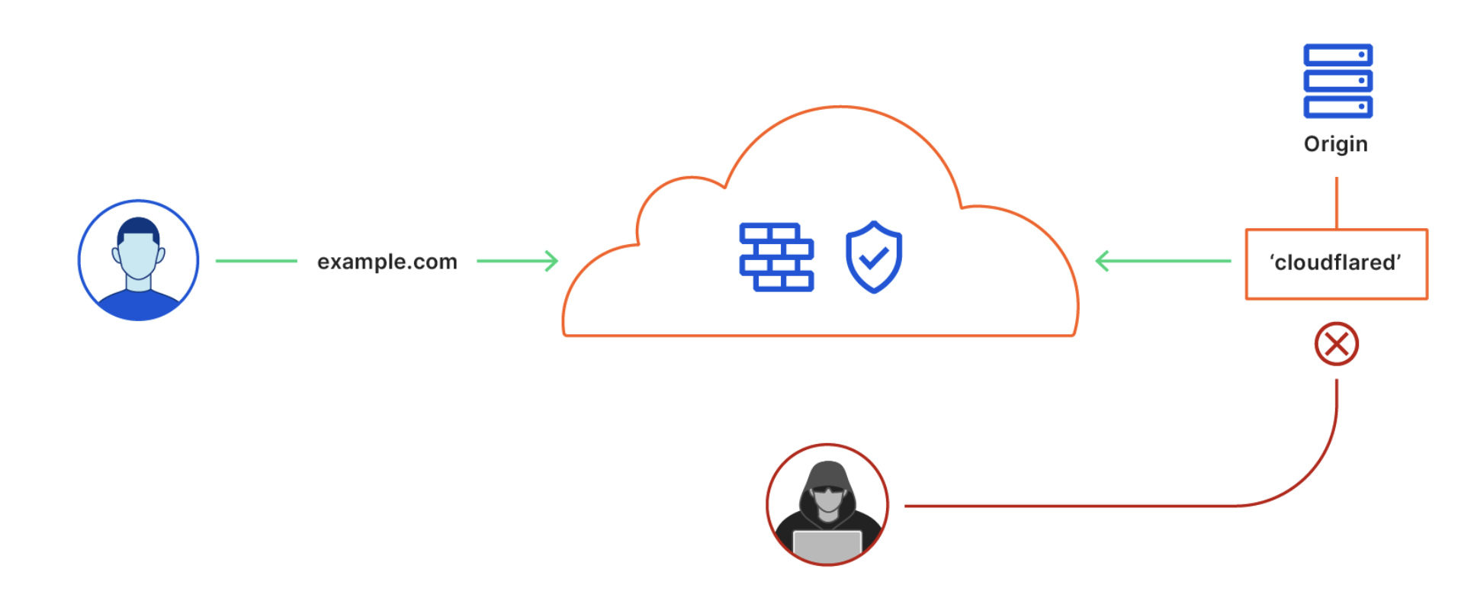

Slide 16
DEMO TIME 🚀🚀

Slide 17
Open Source alternatives?

Slide 18
HashiCorp Boundary
oidc2-proxy

Slide 19
What if we really need a VPN?

Slide 20


Slide 21
What is WireGuard?
Great alternative to OpenVPN & IPSec
Modern, Simple & Robust
Cross Platform
Roaming support
Open Source GPLv3

Slide 22
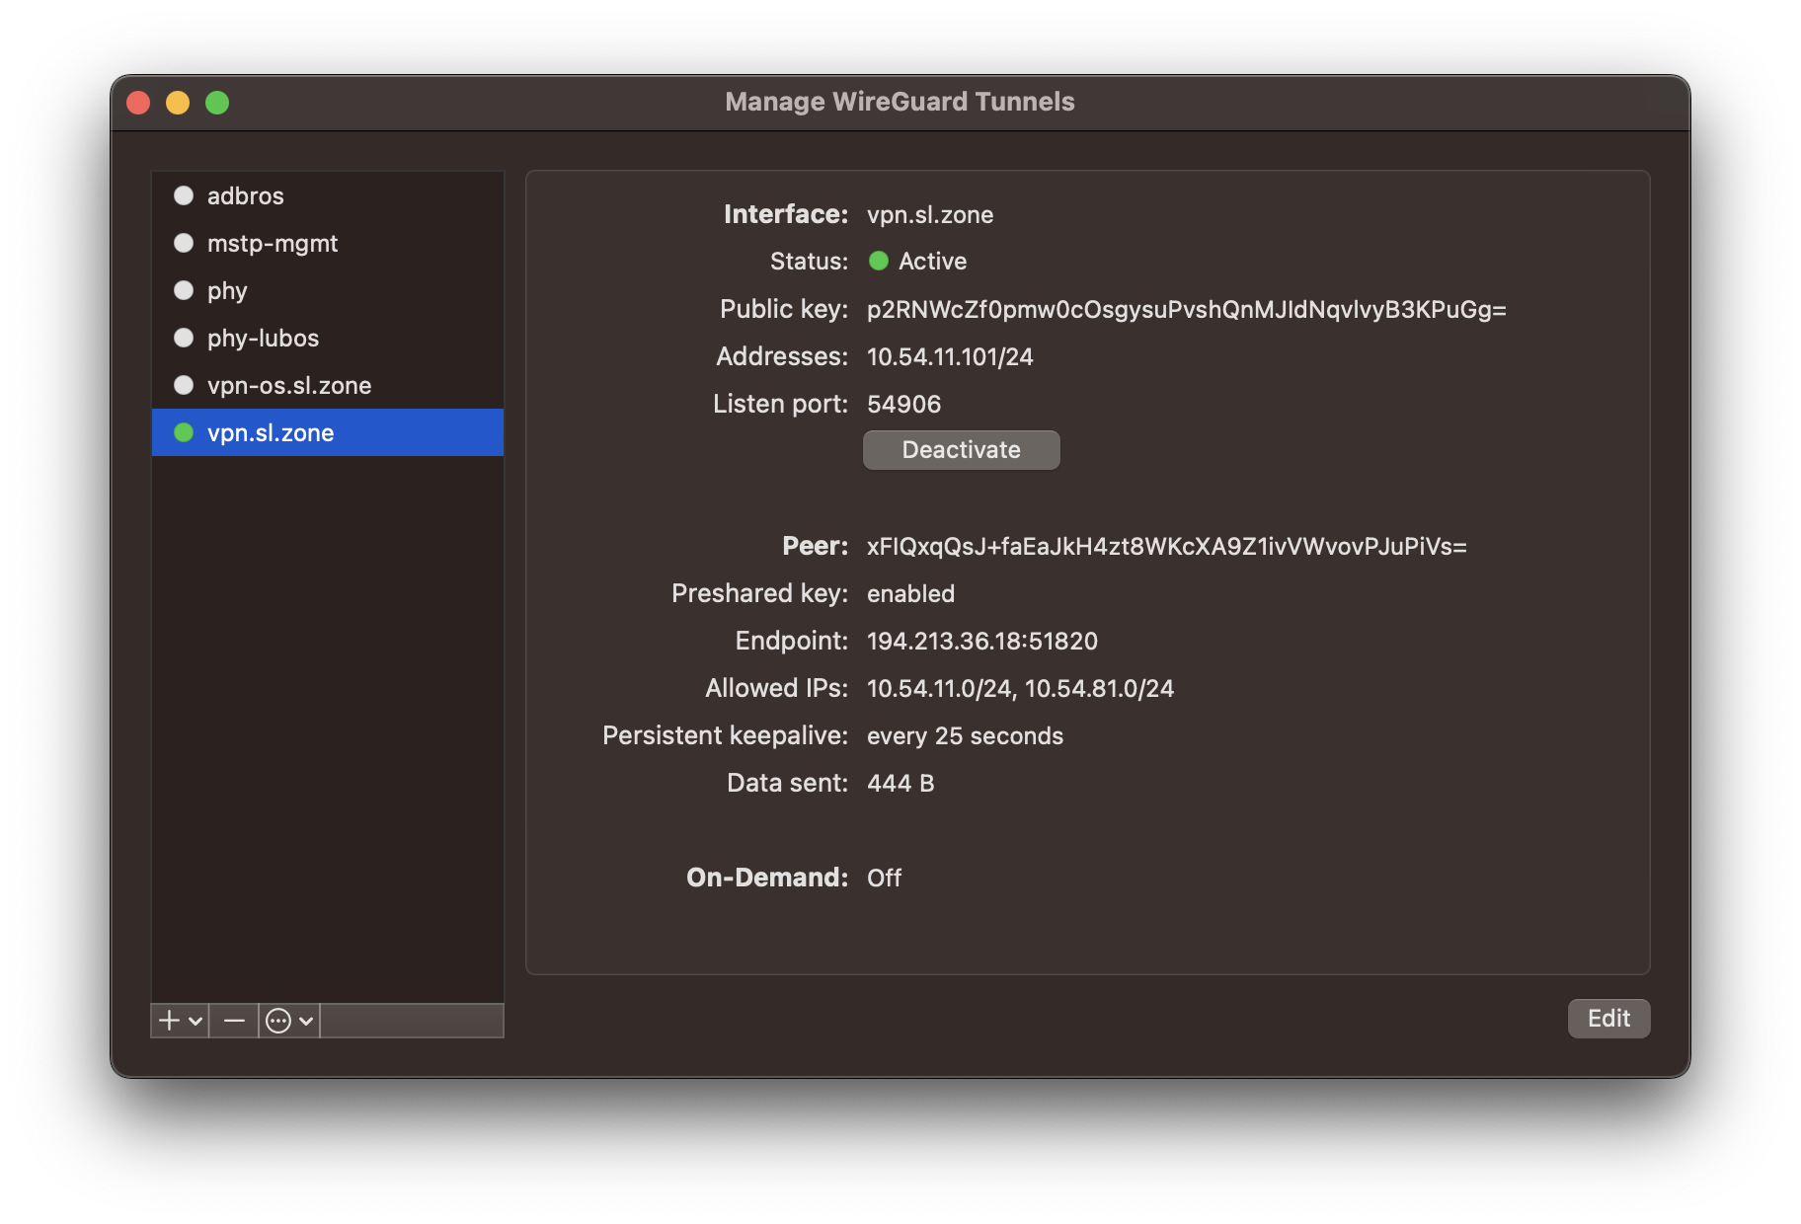

Slide 23
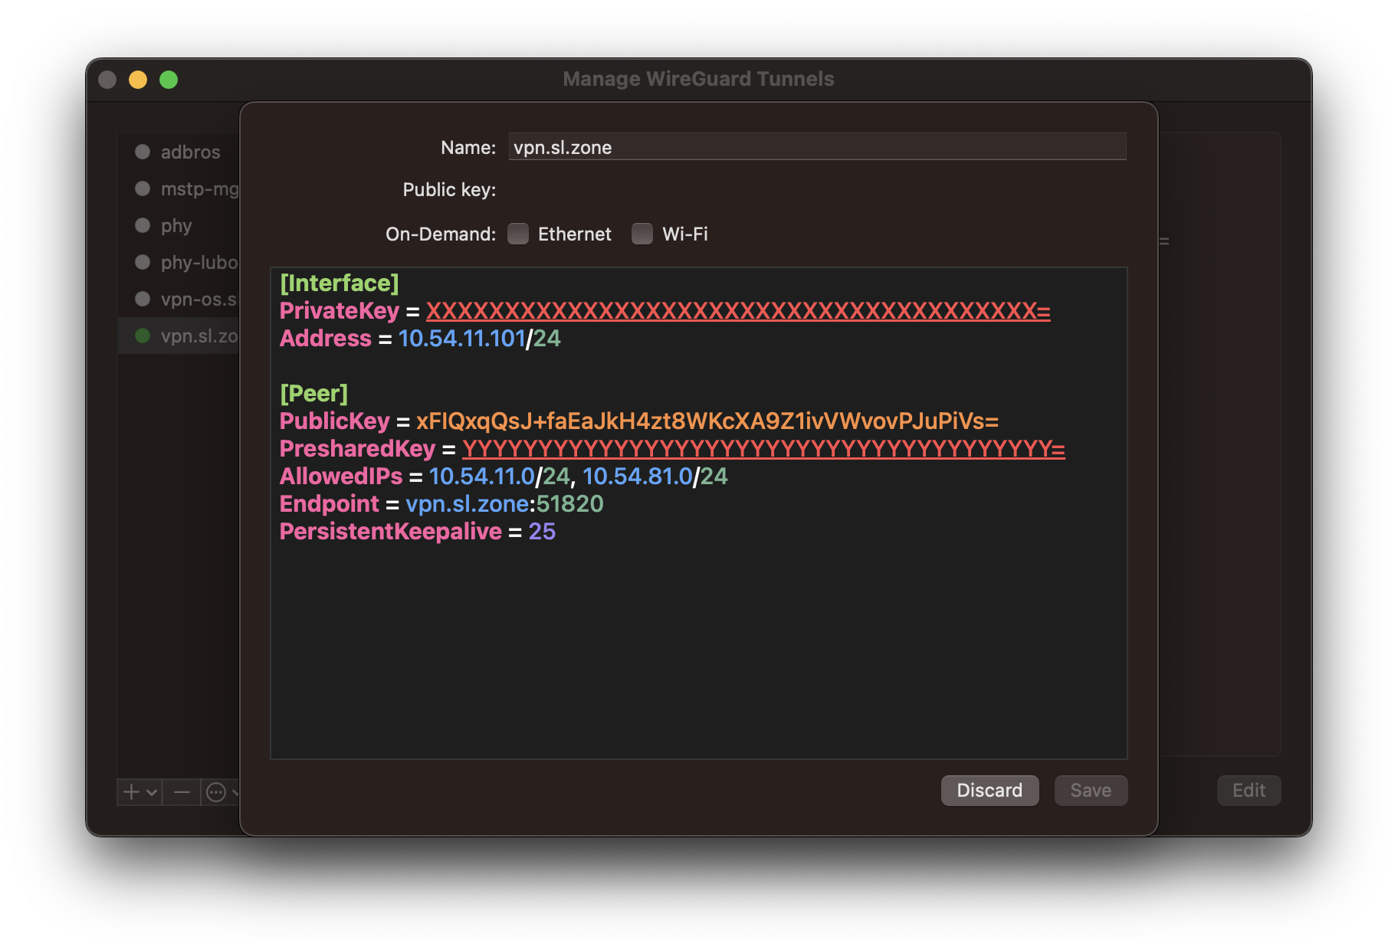

Slide 24
DEMO TIME 🚀🚀

Slide 25
But WireGuard is not so user friendly… 😔

Slide 26


Slide 27
What is Tailscale
Modern managed VPN solution
WireGuard based
Identity based authentication
6 USD / user / mo (3 free users, 100 devices)
Serverless VPN (managed relay servers)
ACL
API & Terraform
Open Source Clients, Open Communication
Great Docs & Blog

Slide 28
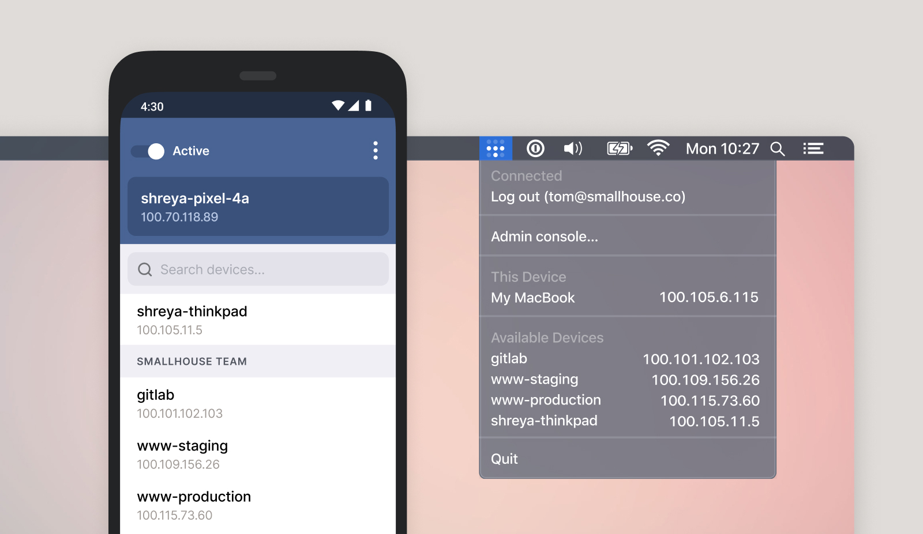

Slide 29
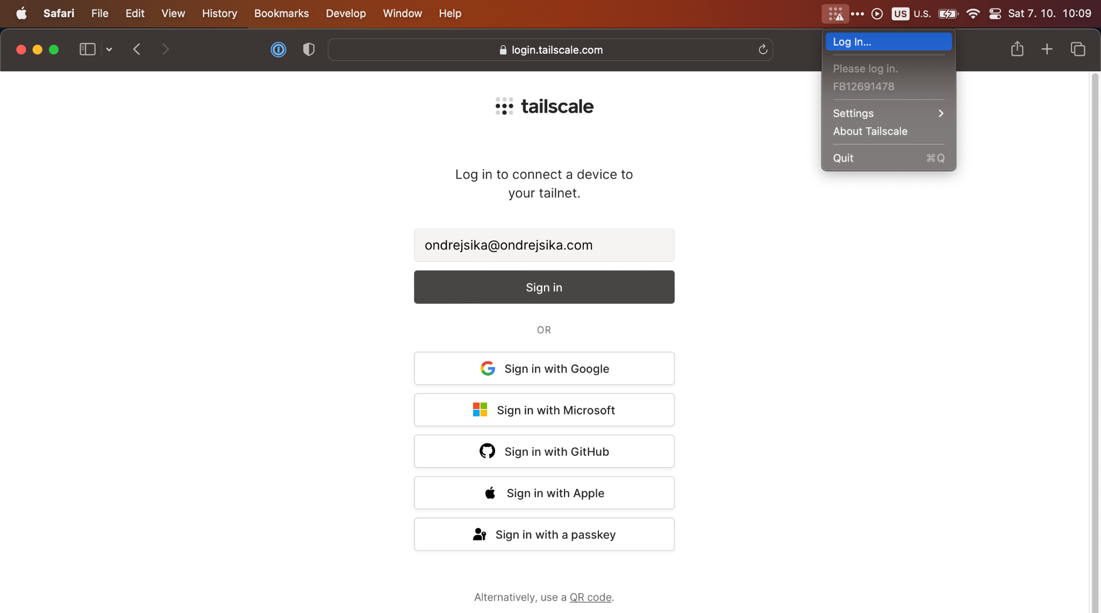

Slide 30
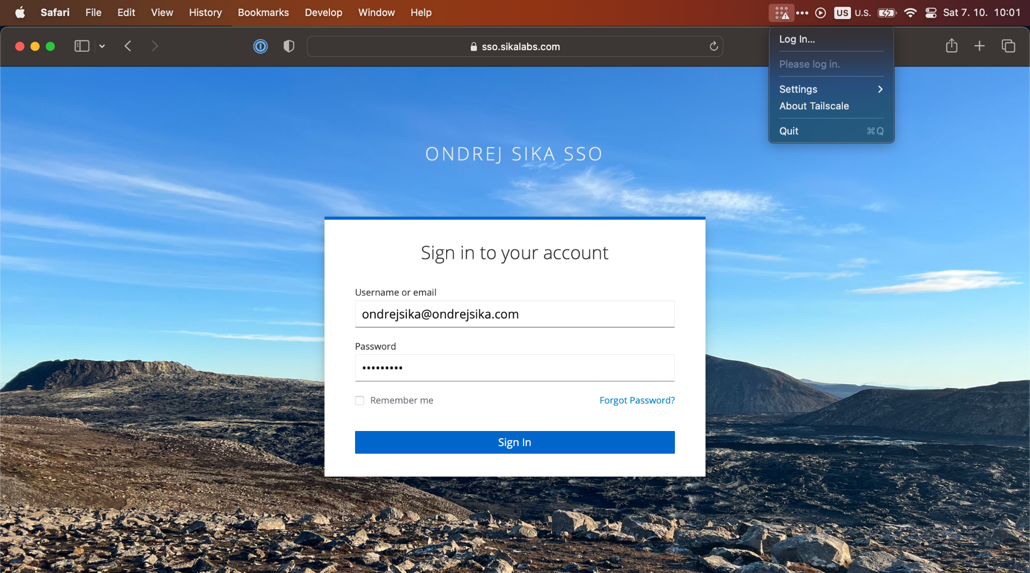

Slide 31
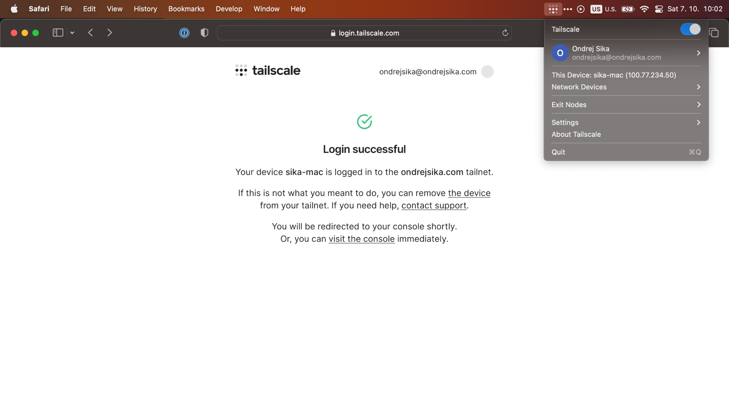

Slide 32
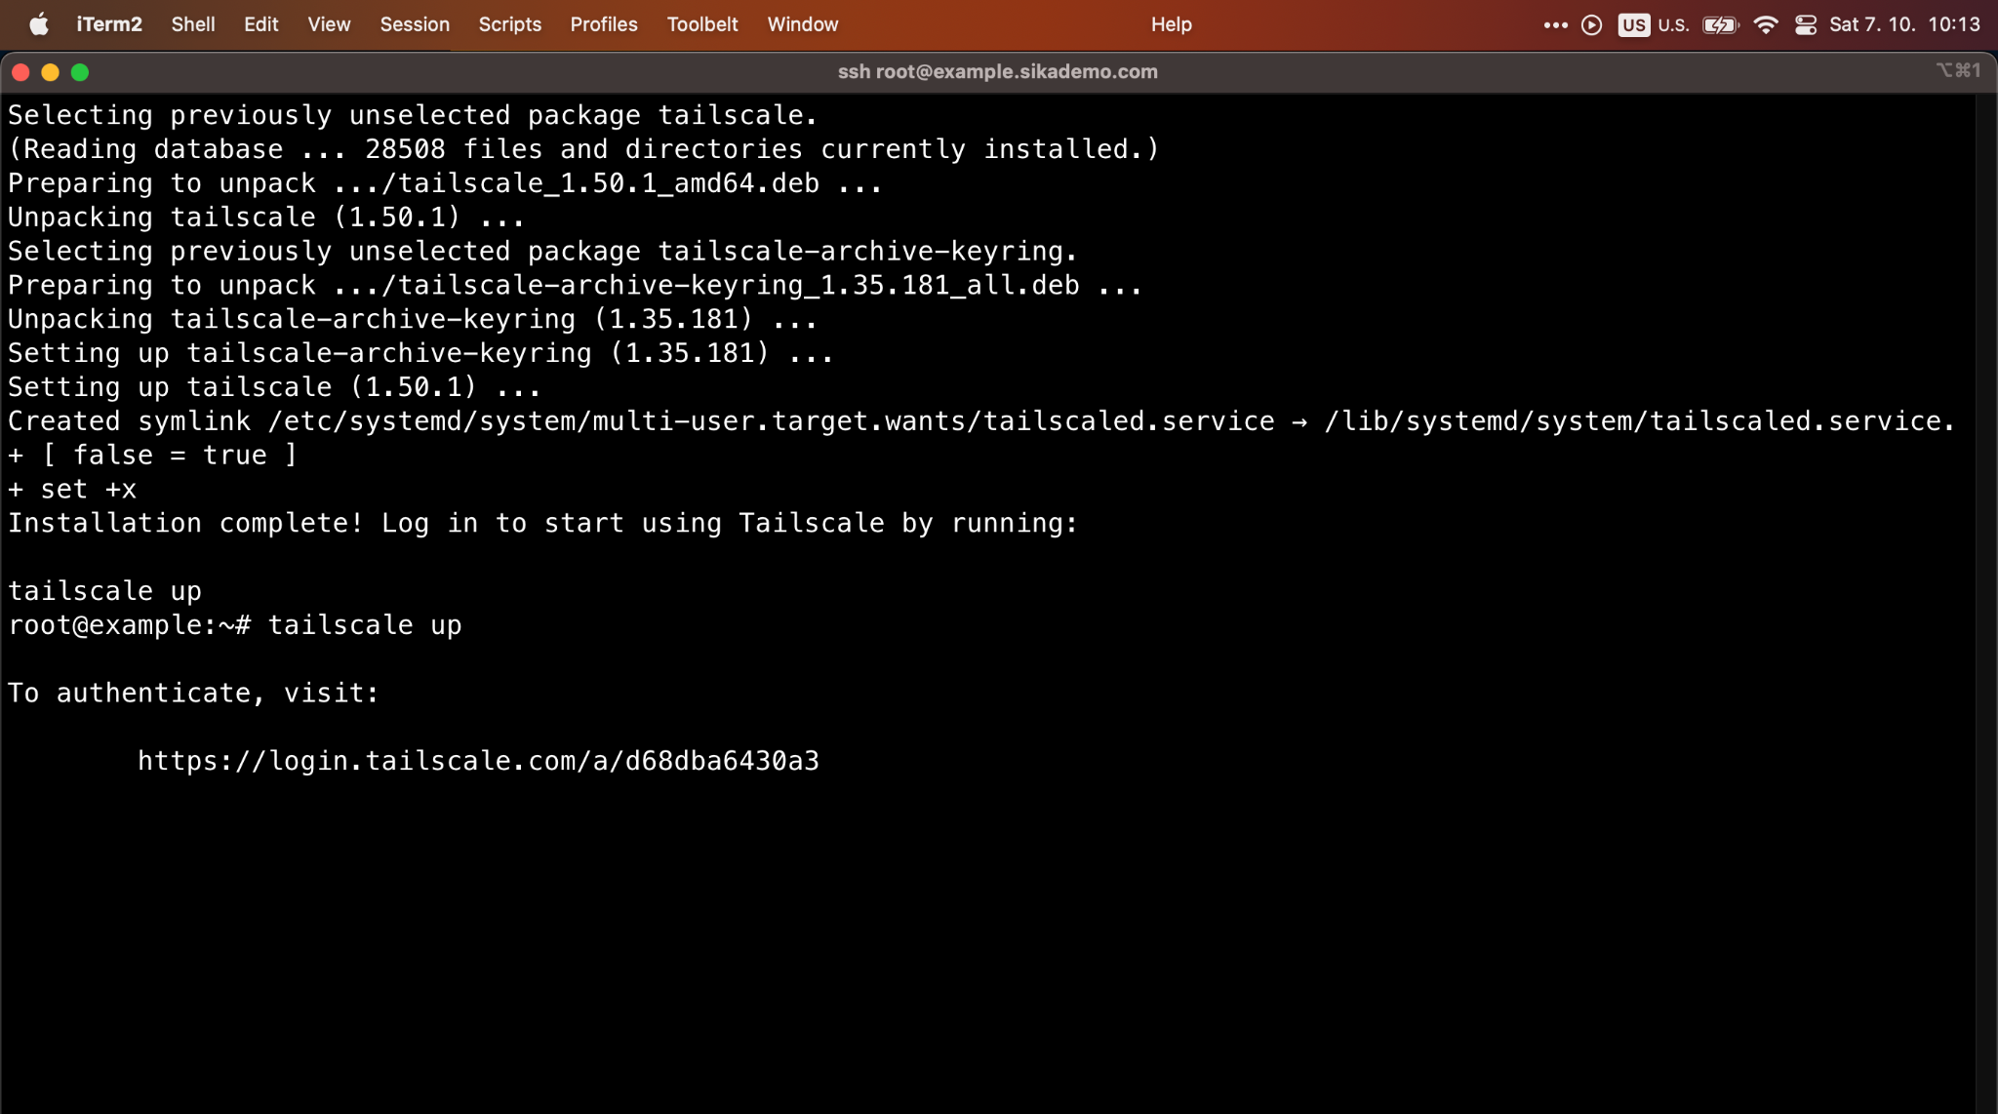

Slide 33
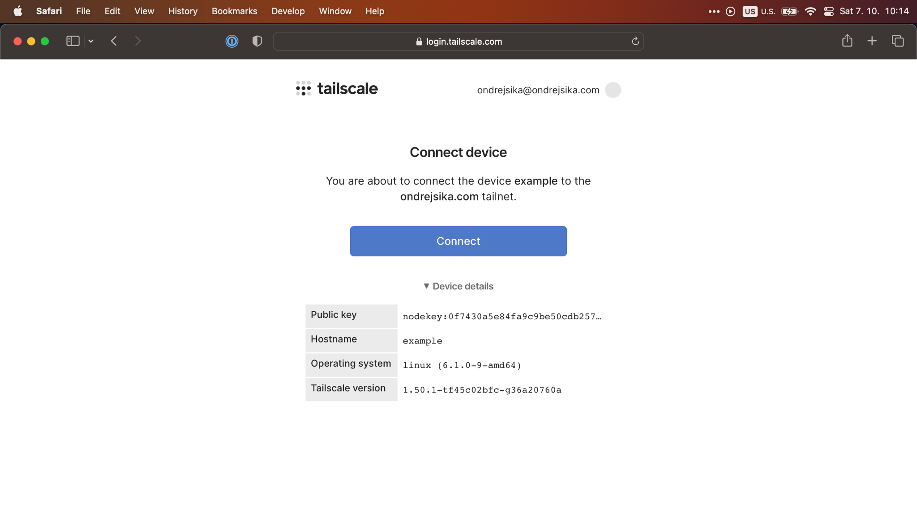

Slide 34
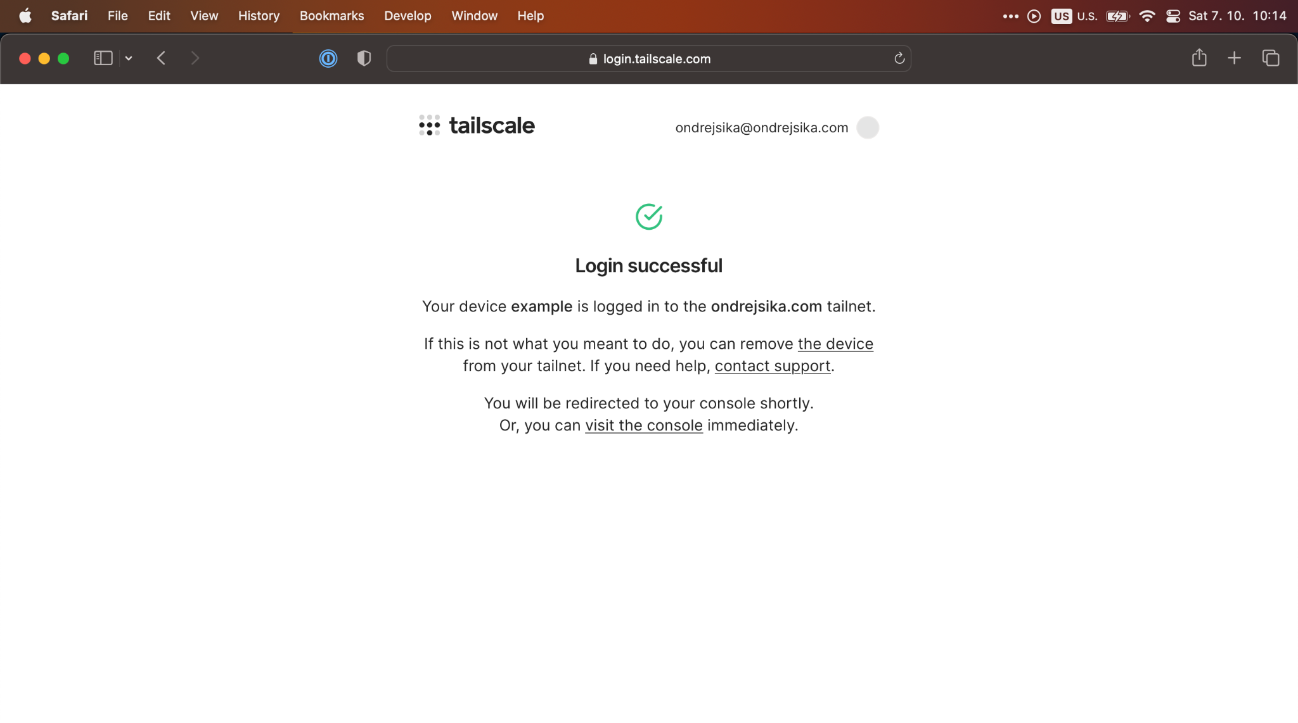

Slide 35
DEMO TIME 🚀🚀

Slide 36
Open Source Tailscale?

Slide 37


Slide 38
What is Headscale
Open Source management server for Tailscale
Same features like Tailscale (except for relays)
No UI (but there are third party UI projects)
Use official Tailscale clients
tailscale up --login-server https://vpn.sl.zone

Slide 39
DEMO TIME 🚀🚀

Slide 40
Thanks for your attention

Slide 41
Questions?

Slide 42
Email ondrej@sika.io
Twitter
@ondrejsika
LinkedIn
/in/ondrejsika
Slides
sika.link/slides

Slide 43
github.com/ondrejsika/linuxdays24-vpn

